Slide 1
A Novel Machine Learning Approach to Preventing Premature Heart Failure Death
Mun Hong Fong, Kyler Kang, Finn Korol-O’Dwyer, Aymane Saissi, Emily Shen
Notes:
Finn

Slide 2
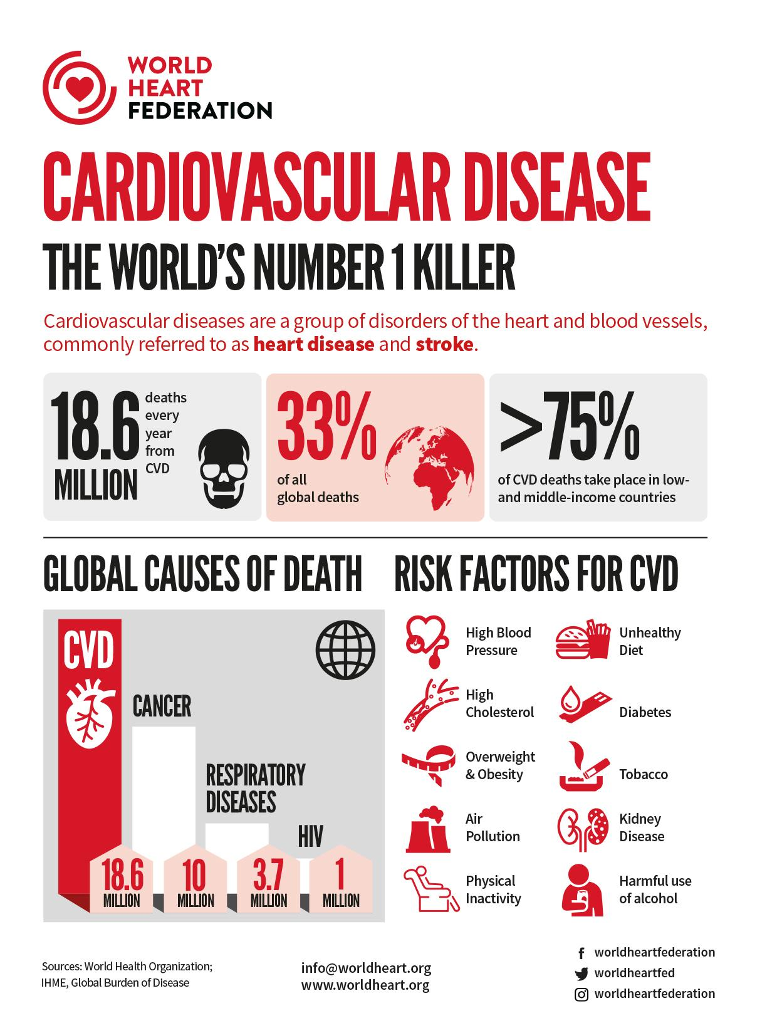
One in every six U.S. healthcare dollars is spent on cardiovascular disease
Medical costs projected to rise to more than $818 billion

Slide 3
Data and Model Plan
Introducing a Machine Learning approach to CD
Dataset is largest of its kind, containing data of over 900 observations
age of the patient, sex of the patient, chest pain type, resting blood pressure, serum cholesterol, fasting blood sugar, resting electrocardiogram results, having ST-T wave abnormality, showing probable or definite left ventricular hypertrophy, maximum heart rate achieved, exercise-induced angina, oldpeak, the slope of the peak exercise ST segment, and the patient’s heart disease positivity
Dataset of diverse data inclusive of many identifiers of risk factors for CD, making it a useful diagnostic tool in conjunction with ML
(Supervised) ML is to be used on this dataset to analyse relationships between variables in upper dimensional space
Model will have the potential to uncover relationships between individual predictors for CD outcomes

Slide 4
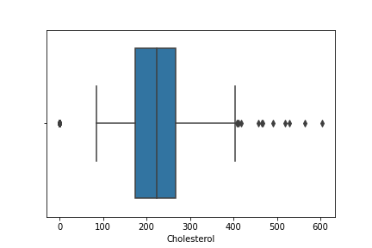
Data Manipulation
A patient with a Cholesterol of 0 is most likely an outlier
Observations with a Cholesterol of 0 were replaced with the median Cholesterol value

Slide 5
Exploratory Data Analysis (Histograms)

Slide 6
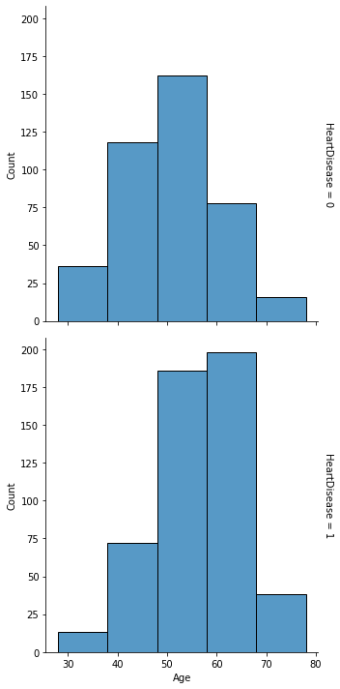
Age
Both distribution of people getting heart disease or not is fairly distributed for both.
Based on the second graph, as we shift up on the age group, the patients getting heart disease increases.
Above age 50, number of people getting heart disease increases

Slide 7
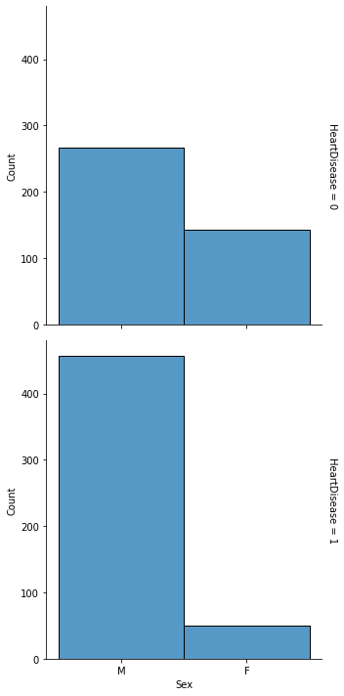
Sex
Most patients are male. (78.9%)
Males have higher chance of getting heart disease, females otherwise.

Slide 8
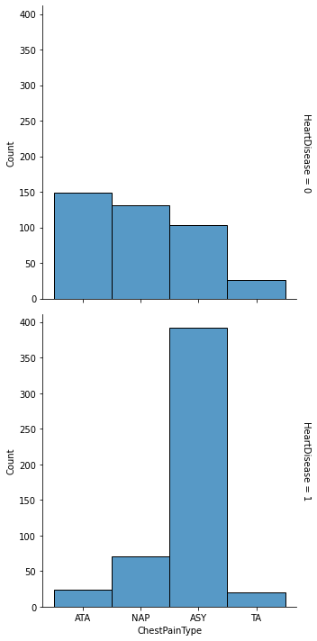
Chest Pain Type
Most patients with heart disease normally have Chest Pain Type ASY (Graph 2)
Least patients with heart disease have Chest Pain type TA (Graph 2)

Slide 9
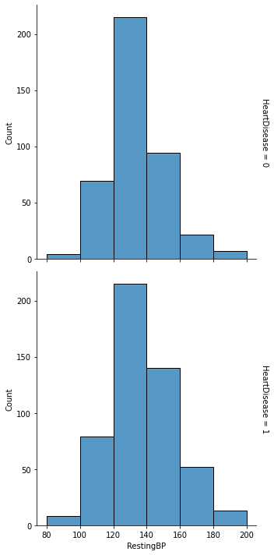
Resting Blood Pressure
Potentially systolic
Both graphs have similar distribution. (Not much info)
Thus, resting blood pressure was not a main focus of our analysis

Slide 10
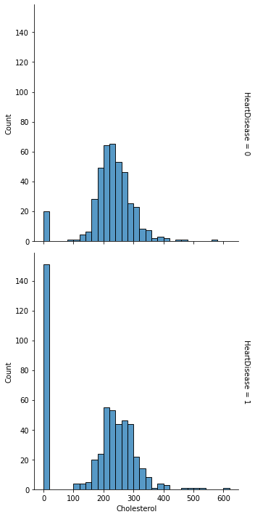
Cholesterol
Similar distribution for both patients who have heart disease or not.
Notice the 0 bar on the cholesterol graph, replaced with median afterwards, as it is highly unlikely data and considered outliers

Slide 11
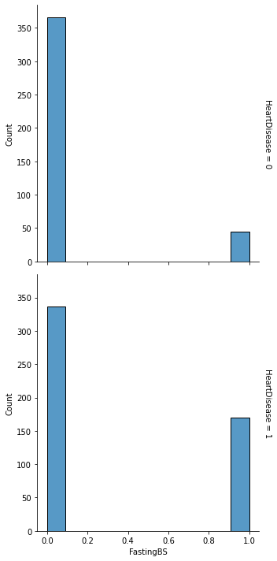
Fasting Blood Sugar
1 indicates Fasting BS > 120 mg/dl; otherwise 0
Patients who have heart disease are more likely to have a higher Fasting BS
Notes:
Kyler

Slide 12
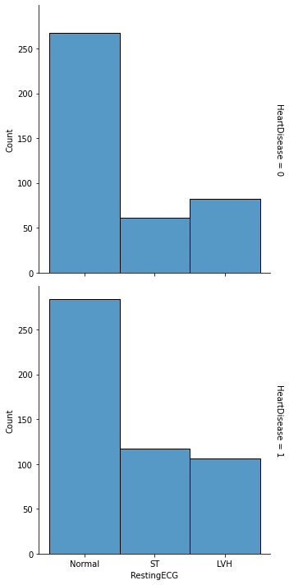
Resting Electrocardiogram
Similar distribution of graphs.
We concluded that Normal Resting ECG is not an indication of having heart diseases.
Notes:
Kyler

Slide 13
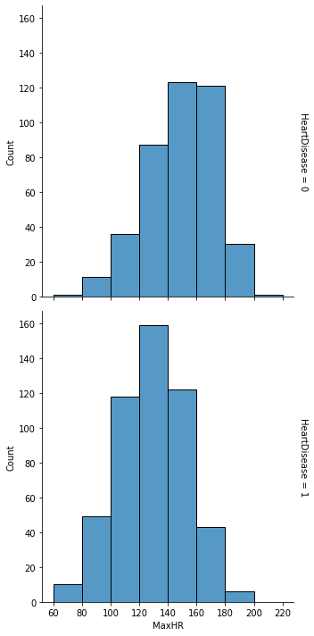
Maximum Heart Rate
Similar distribution of both graphs
Patients having heart disease are having lower heart rate histogram distribution. (Conflict?)
Notes:
Kyler

Slide 14
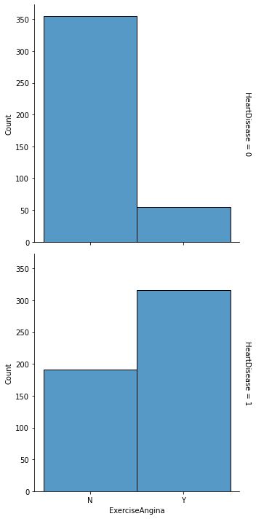
Exercise Induced Angina
Patients who have heart disease are most likely to suffer from Exercise Induced Angina, vice versa.
Notes:
Kyler

Slide 15
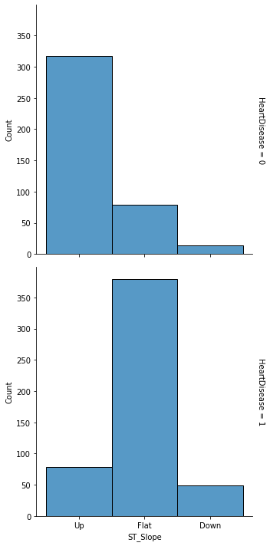
ST Slope
Patients with Flat ST Slope are most likely to have heart disease.
Patients with Upward ST Slope are least likely to have heart disease.
Notes:
Kyler

Slide 16
Analysis (Correlation)

Slide 17

ST_Slope_Up is most strongly negatively correlated with Heart Disease, Max Heart Rate and Chest Pain ATA comes after.
Chest Pain ASY and Exercise Induced Angina is strongly positively correlated with Heart Disease

Slide 18
Machine Learning Models

Slide 19
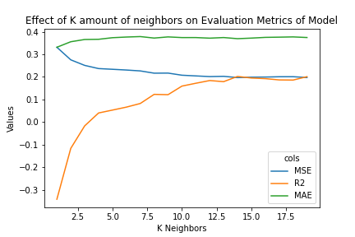
K-Nearest Neighbours
Optimal number of k neighbors was ~10 neighbors
When k = 10
MSE: 0.207
MAE: 0.374
R^2: 0.159
Notes:
Kyler

Slide 20
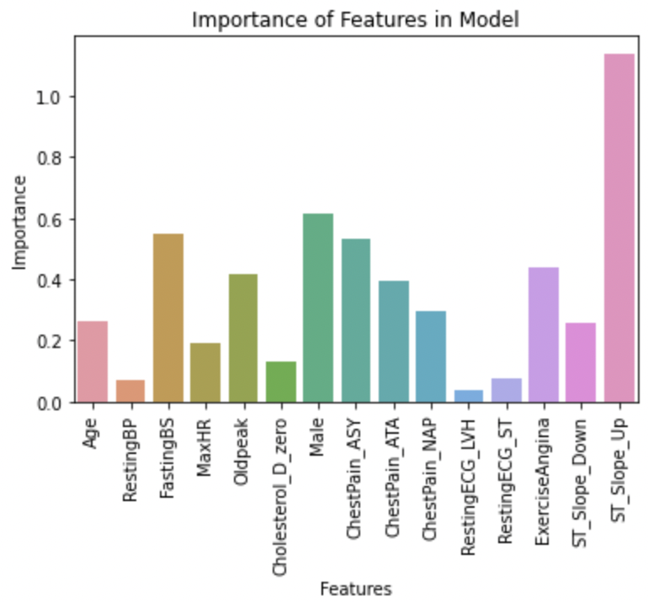
Logistic Regression
Logistic Regression Model uses standardized data, 80/20 train test split
Accuracy: 0.864
ROC Curve Score: 0.912
Predictions Results
 | Predicted 0 | Predicted 1
Actual 0 | 76 | 13
Actual 1 | 12 | 83
Notes:
Kyler

Slide 21
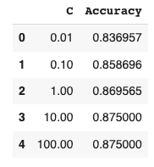
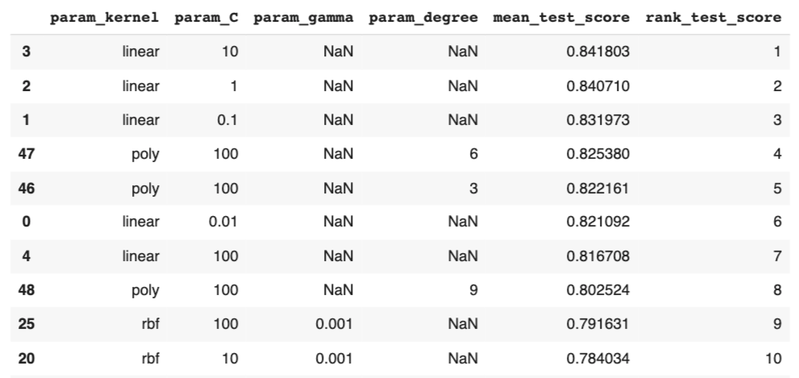
Support Vector Machines (SVM)
SVM used 80/20 train test split
Fitted where C = 10 and using a linear kernel function
Accuracy: 0.875
 | Predicted 0 | Predicted 1
Actual 0 | 71 | 11
Actual 1 | 12 | 90
Notes:
Emily

Slide 22
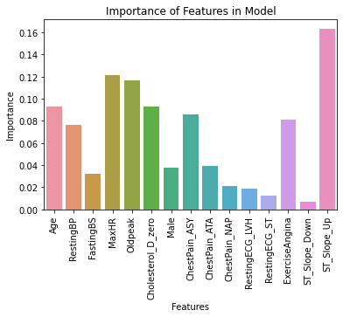
Random Forests
Random Forests used scaled data, 80/20 train test split. Optimal number of decision trees was 275 and number of features per split was 2
Accuracy: 0.876
 | Predicted 0 | Predicted 1
Actual 0 | 410 | 0
Actual 1 | 0 | 507
Notes:
Finn

Slide 23
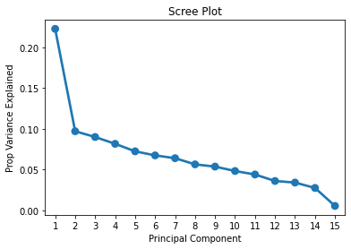
Dimension Reduction
Principal Components Analysis was used to identify whether any variables contained more information than others
It was found that none were worthy of removal
Notes:
Finn

Slide 24
Scope and Significance
Models provide a moment-in-time risk assessment for heart failure due to nature of data
Does not identify if patient will remain low or high risk over time
Possible implementation in cardiologist’s office
Input ECG, blood work results, etc to return binary heart failure risk
Advise patient of immediate risk and potential prevention strategies based upon feature insights
Models support importance of ST Slope, but few other overlapping features.
Could ML challenge what we know about heart failure prediction? Is there more than one set of features to use?
Notes:
Finn

Slide 25
Summary
Dimensions were analyzed and none were removed
Product model was a logistic regression
Occam’s razor
Model has the capability to predict patient’s binary heart failure risk
Model dimension significances can offer insights in the clinical setting for weighing risk
ST Slope very important, asymptomatic chest pain important, exercise angina important, unclear importance of max heart rate

